Slide 1
MongoDB CRUD Operations

Slide 2

Creating database

Slide 3

insertOne

Slide 4

insertMany

Slide 5
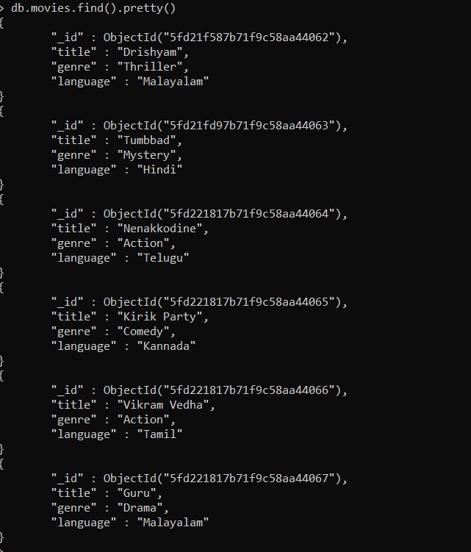
find() & pretty()

Slide 6

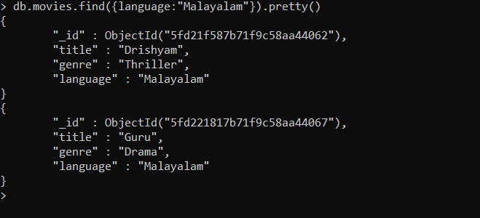
findOne()

Slide 7
updateOne

Slide 8

updateMany

Slide 9
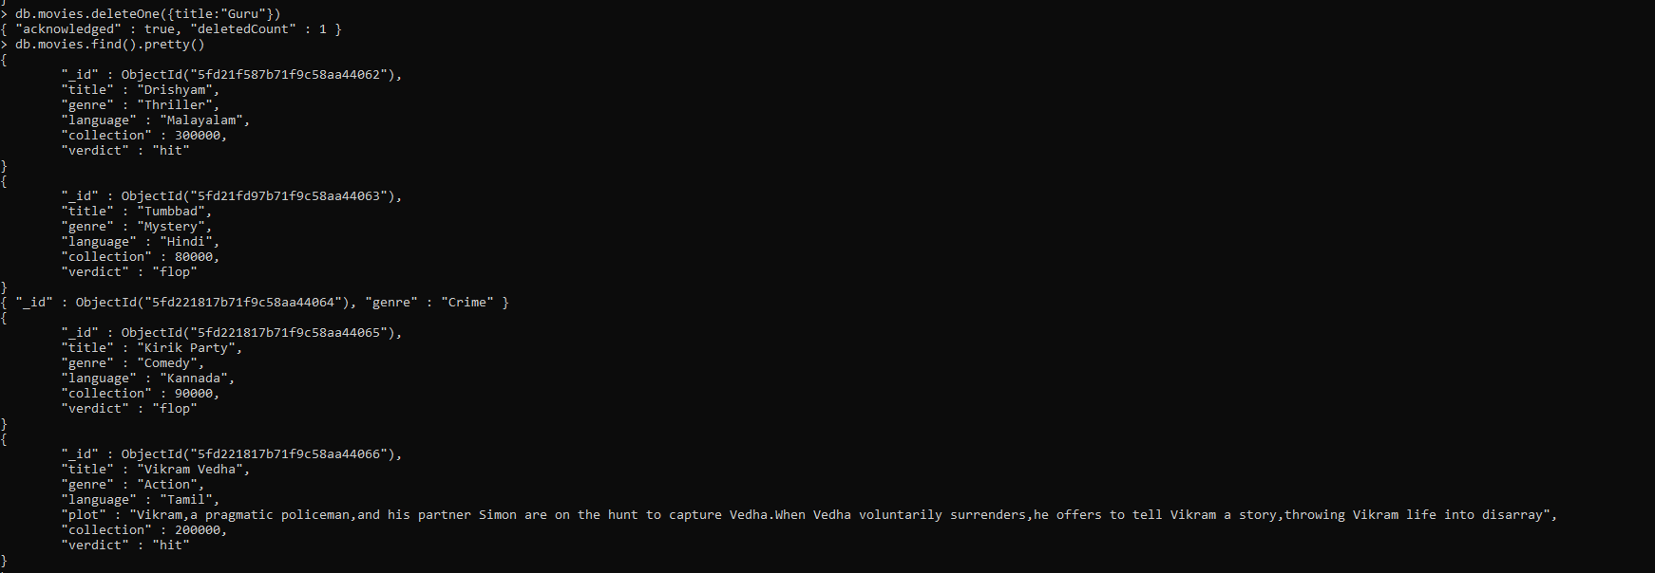
deleteOne

Slide 10

deleteMany

